Slide 1

DIGITAL ELECTRONICS
III Semester ECE
Dr. Ranjita Rout
DEPARTMENT OF ELECTRONICS AND COMMUNICATION ENGINEERING
SCHOOL OF ENGINEERING & TECHNOLOGY
GIET UNIVERSITY, GUNUPUR, ODISHA

Slide 2
Flip-Flop Analysis;
Conversion of Flip-Flops

Slide 3
Flip-Flop Analysis
Characteristic Table: A characteristic table defines the logical properties of a flip-flop by describing its operation in tabular form.
Characteristic Equation: The logical properties of a flip-flop, as described in the state table, can be expressed algebraically with a characteristic equation.

Slide 4
State Table: The time sequence of inputs, outputs, and flip-flop states can be enumerated in a state table (sometimes called a transition table).
The table consists of three sections labeled present state, inputs, and next state.
State Diagram: The information available in a state table can be represented graphically in the form of a state diagram.

Slide 5
In this type of diagram, a state is represented by a circle, and the (clock-triggered) transitions between states are indicated by directed lines connecting the circles.
The binary number inside each circle identifies the state of the flip-flops.
The directed lines are labeled with two binary numbers separated by a slash.

Slide 6
The input value during the present state is labeled first, and the number after the slash gives the output during the present state with the given input.
Excitation Table: A table that lists the required inputs for a given change of state is called an excitation table.

Slide 7
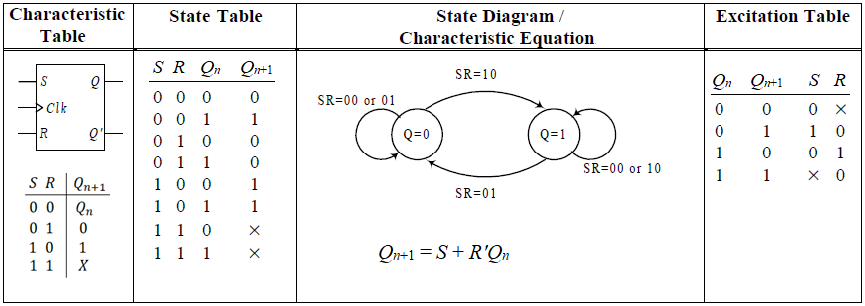
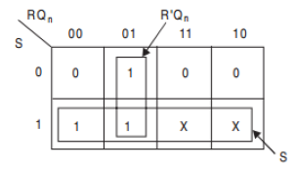
SR Flip-Flop

Slide 8
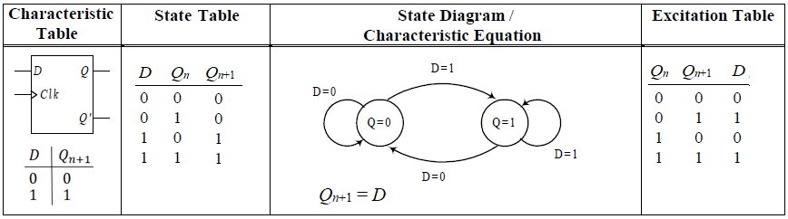
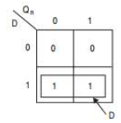
D Flip-Flop

Slide 9
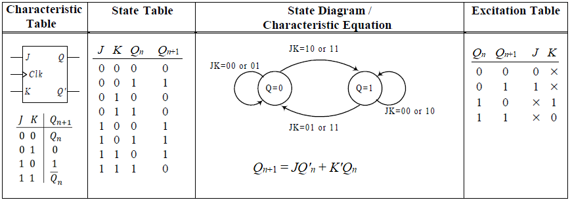
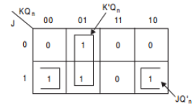
JK Flip-Flop

Slide 10
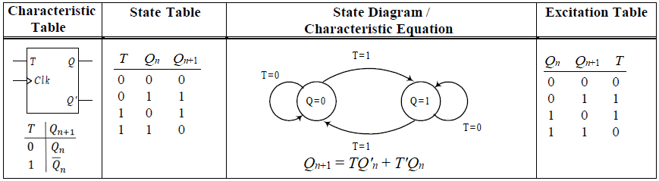
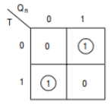
T Flip-Flop

Slide 11
Conversion of Flip-Flops
To convert one type of flip-flop into another type, a combinational circuit is designed such that if the inputs of the required flip-flop are fed as inputs to the combinational circuit and the output of the combinational circuit is connected to the inputs of the actual or given flip-flop, then the output of the actual or given flip-flop is the output of the required flip-flop.

Slide 12
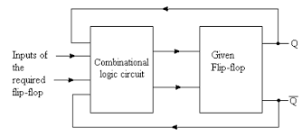

Slide 13
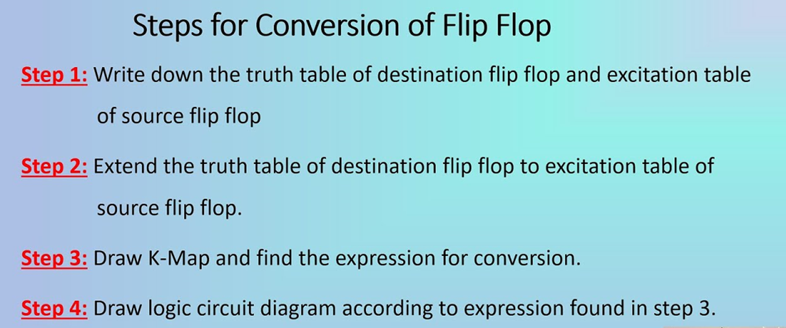

Slide 14
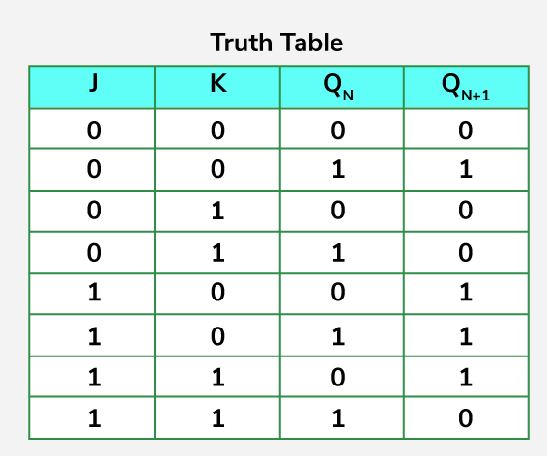
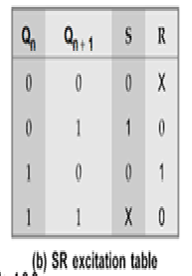
Step -1

Slide 15
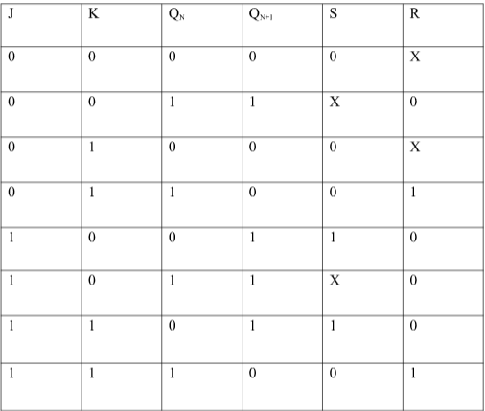
Step-2

Slide 16
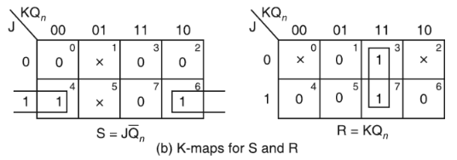
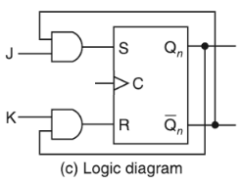
Step-3

Slide 17
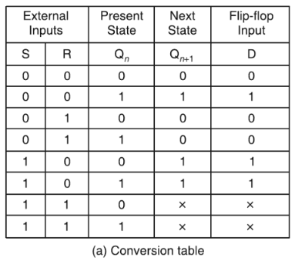
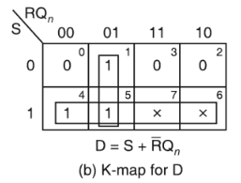
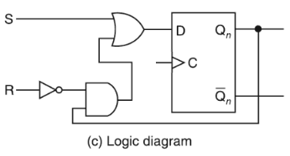
Conversion of an D Flip-flop to a S-R Flip-flop.

Slide 18
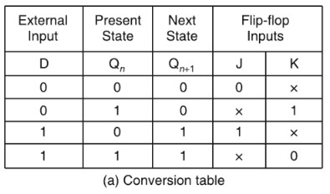
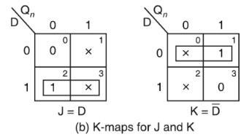
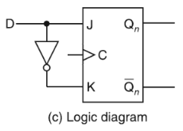
Conversion of an J-K Flip-flop to a D Flip-flop.

Slide 19
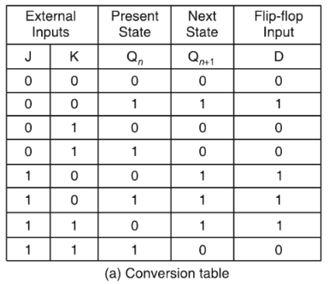
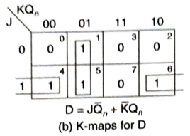
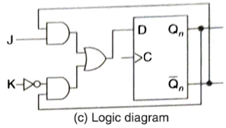
Conversion of an D Flip-flop to a J-K Flip-flop.

